Slide 1



Timer

Slide 2
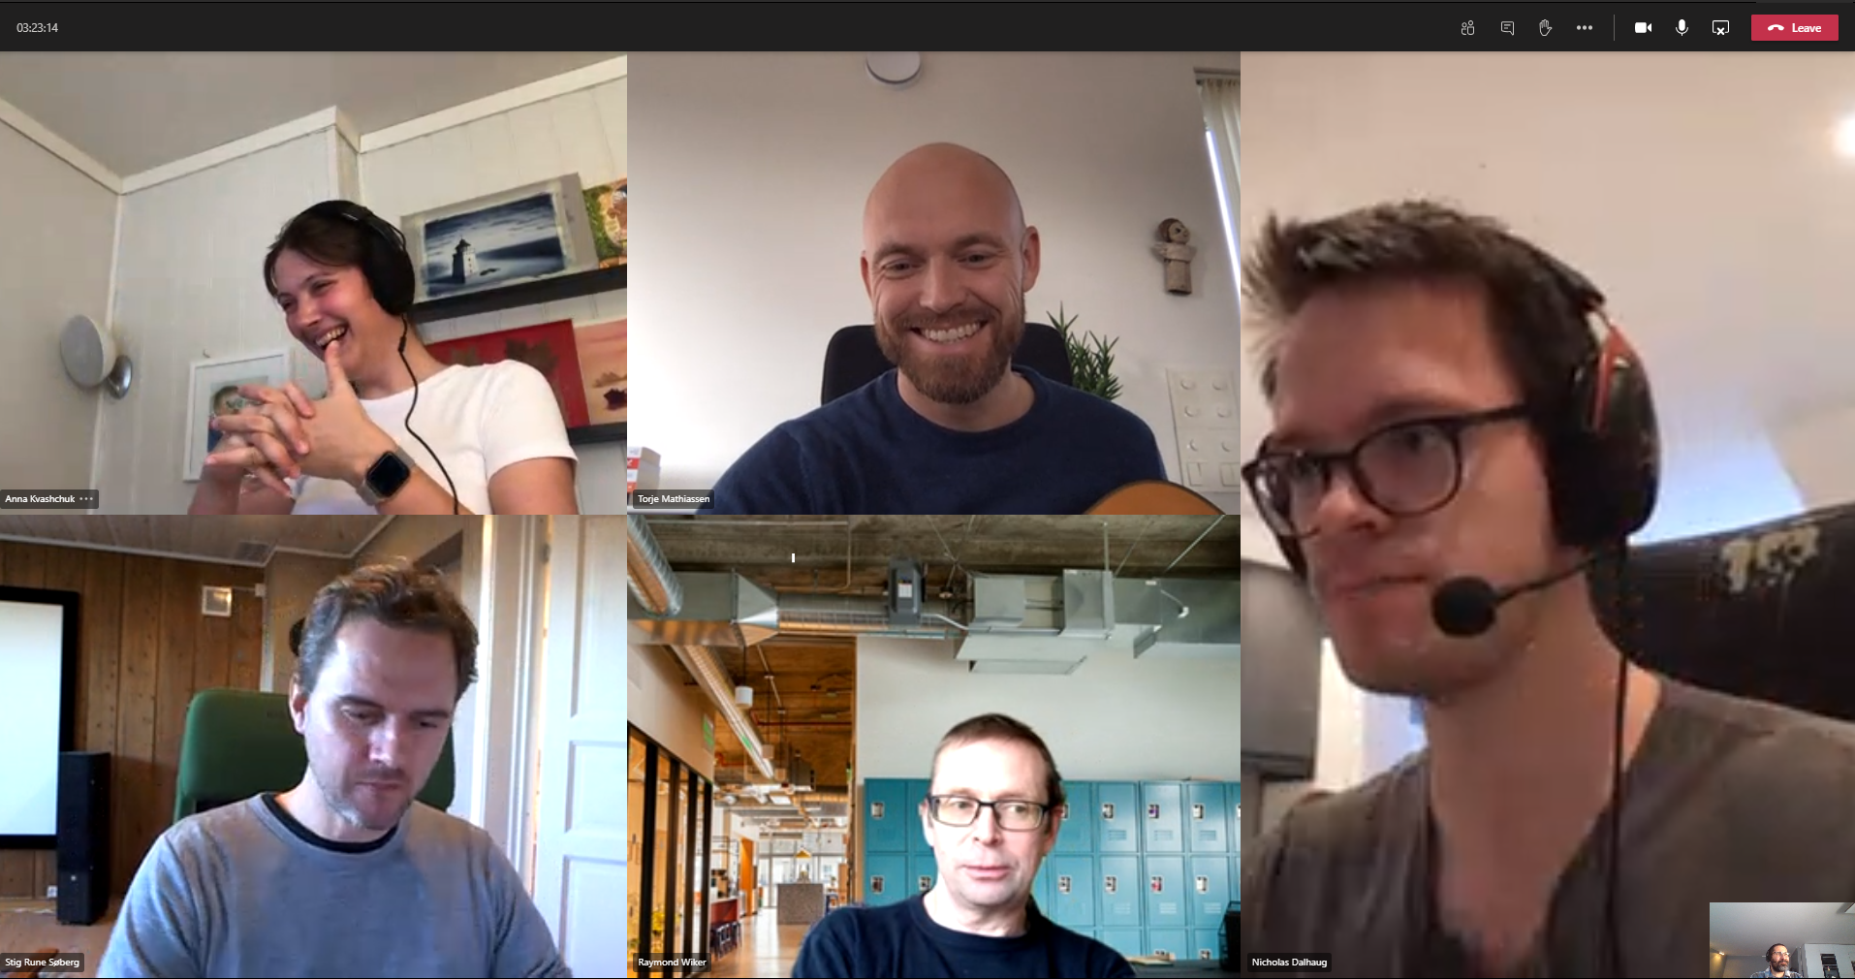


Slide 3
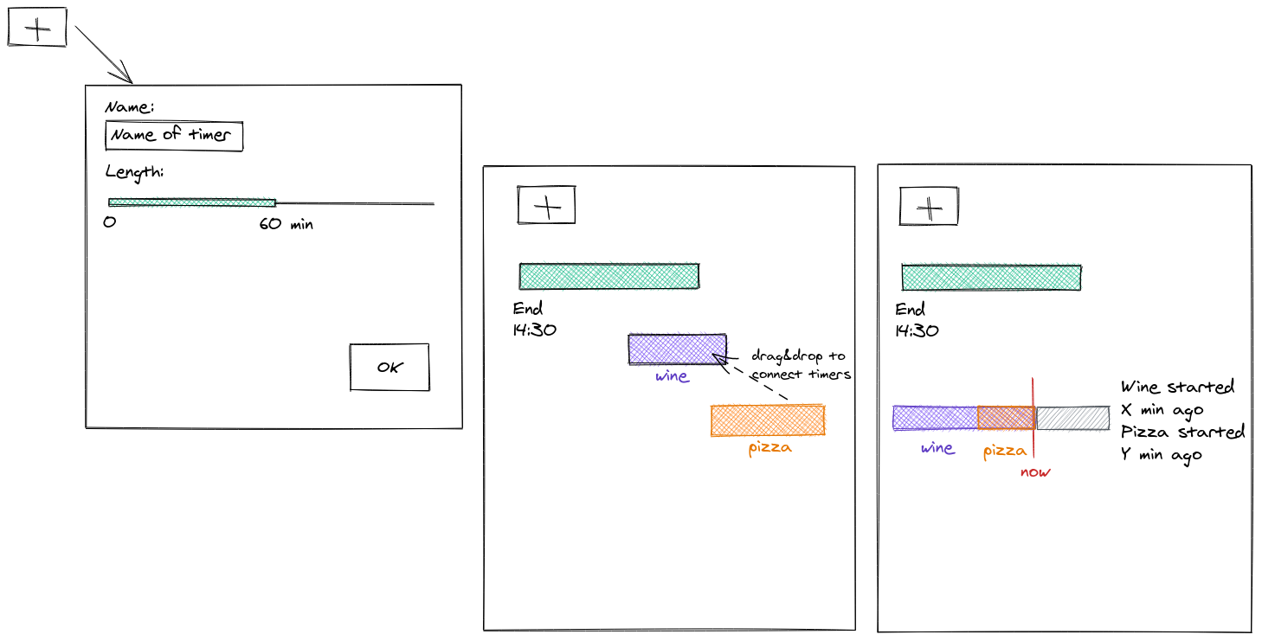
DEMO
Go to

Slide 4
Technology Stack
Azure AD/ OAuth 2 Access Control
EDS
Azure
Git/ GitHub
React
Radix
Node
Docker
Restfull API
Flask

Slide 5


Collaborate: to work together especially in some literary, artistic or scientific undertaking. <Webster Dictionary>
Way Of Working: The Pillars

Slide 6

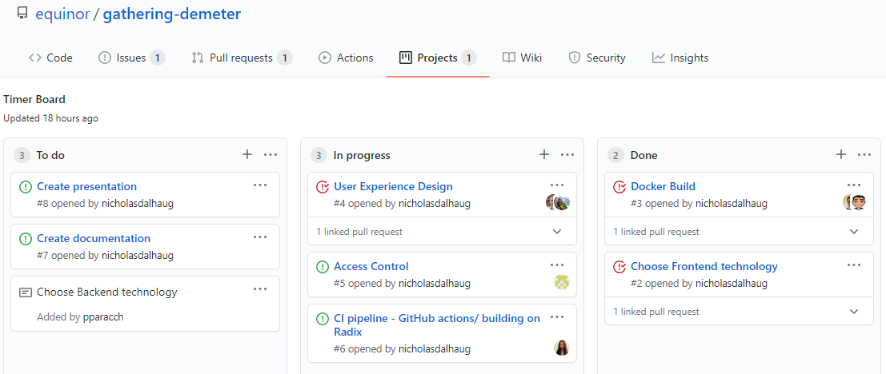
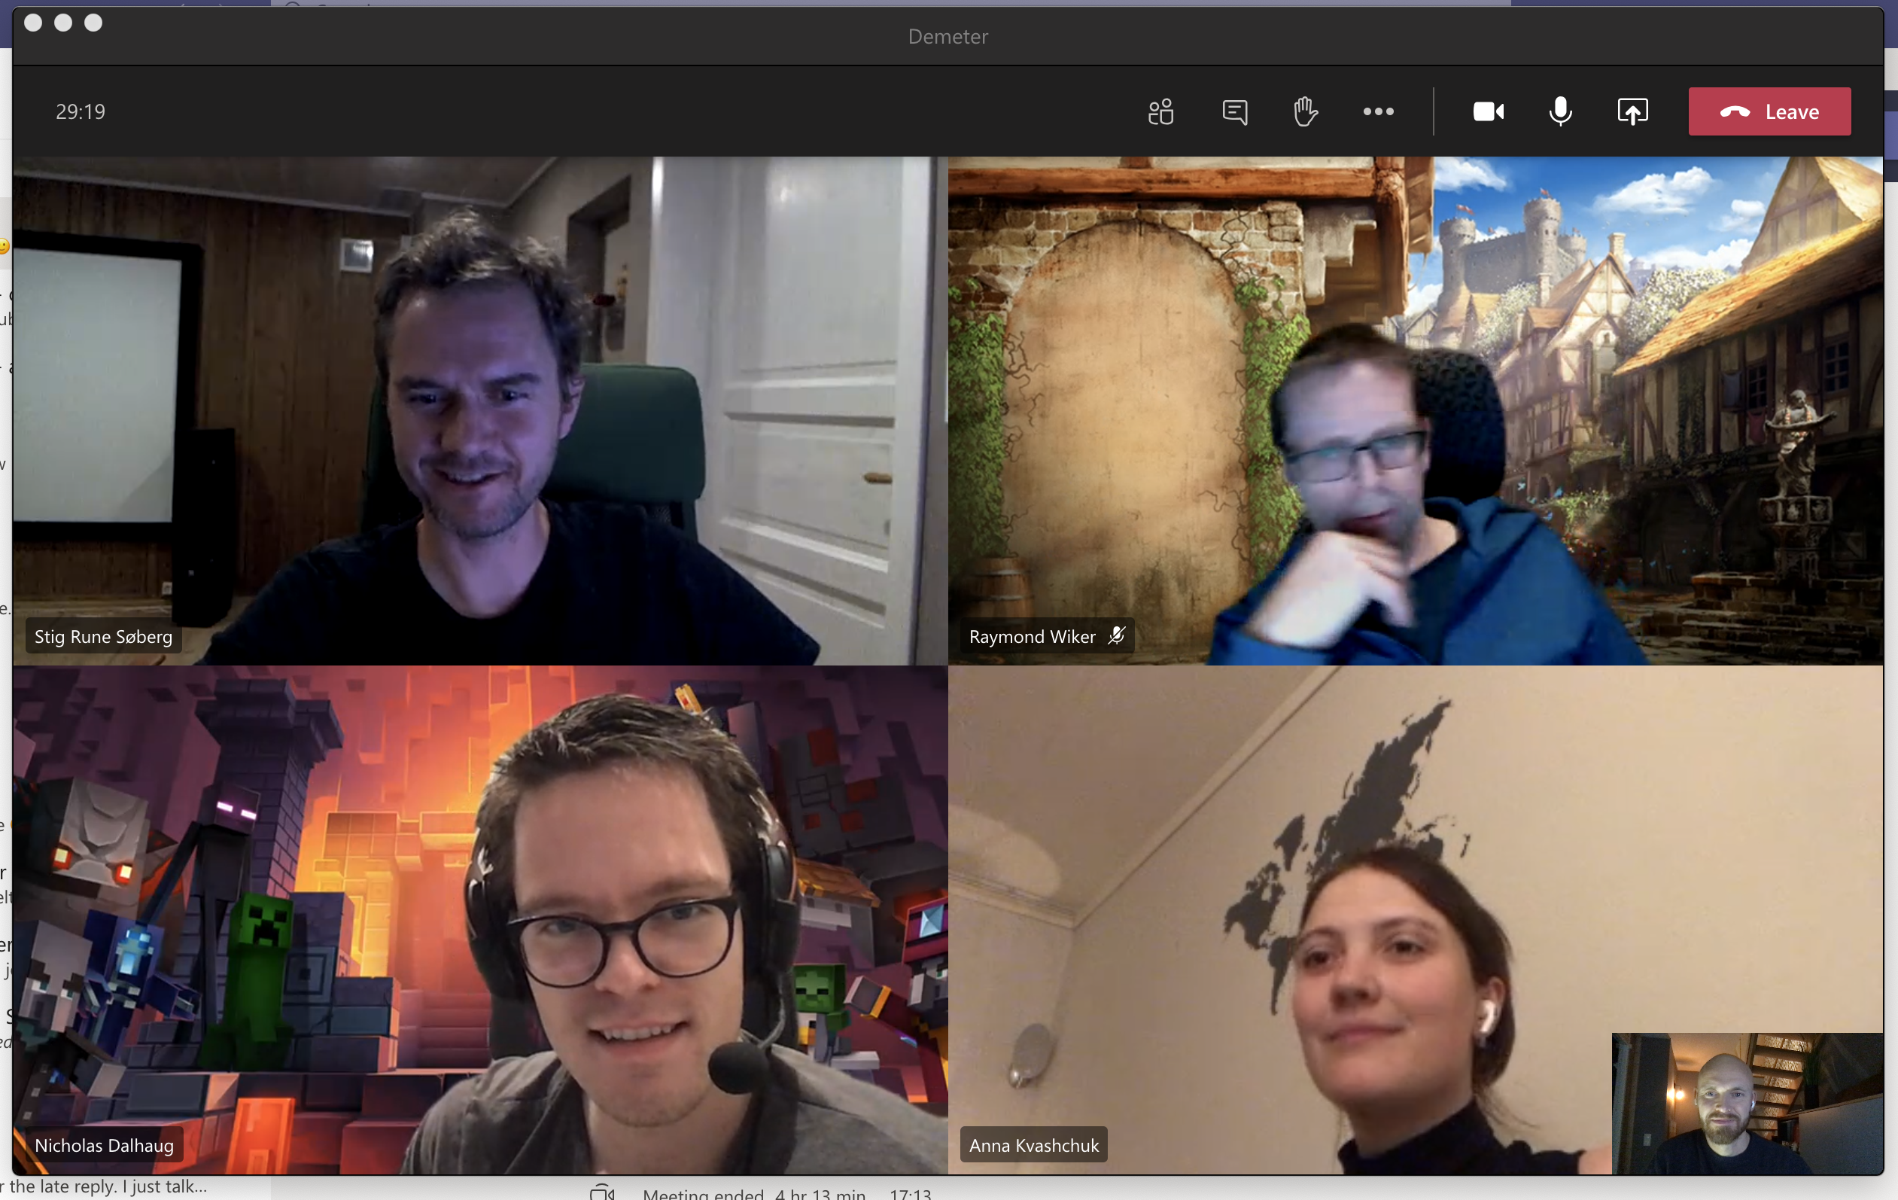


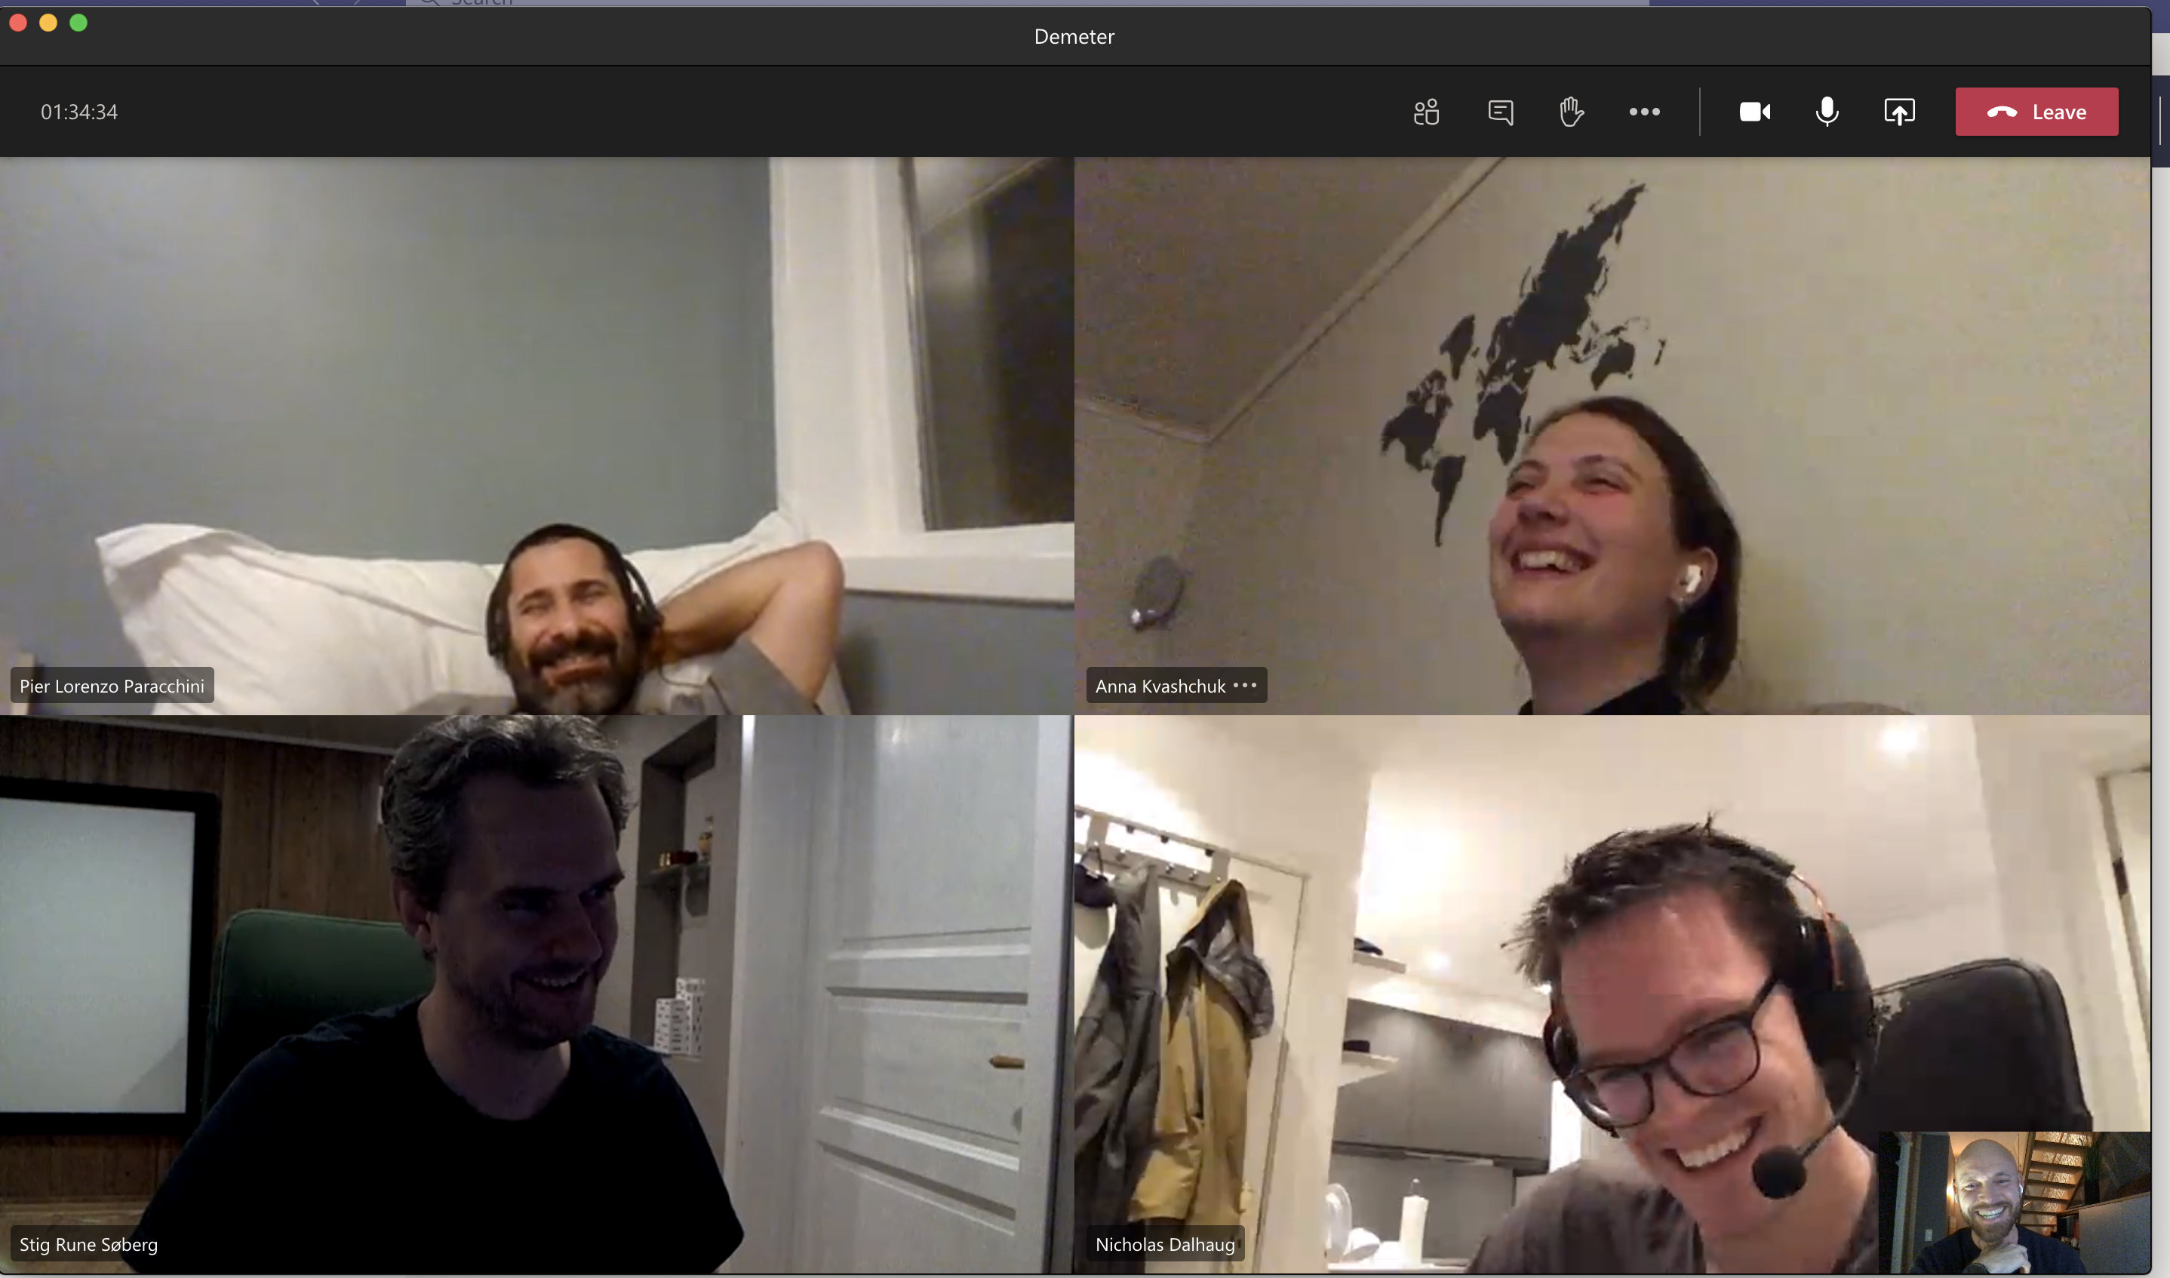

Way Of Working: The Process
PDCA
Plan
Do
Check
Act
2 or more people working together on the same task
Iterative and Incremental Approach

